Slide 1
Network Analysis
Maram Bani Younes

Slide 2
Contents

Slide 3
Network Analysis
Is the process of listening and analyzing Network Traffic.
  Capture Network Traffic
  Filter It
  Analyze it (Statically)

Slide 4
What is purpose of Network Analysis?
Performance Problem.
Analyze Application Behavior
Troubleshooting
Locate and detect Security Breaches

Slide 5
Tools of Network Analysis
Paessler PRTG
SolarWinds Network Performance Monitor
NetSpot
Wireshark
Nagios.
Etc.

Slide 6
WireShark
What is Wireshark?
  One of the most known powerful network traffic analysis.
  Free
  Open source
  Cross Platform.
Installing Wireshark:
  www.wireshark.org
  Enable update in Windows.
  KB2999226 and KB348401

Slide 7
What is WinPCap?
Windows Packet Capture
It is capture and filtering engine for many open source and commercial network tools. Including protocol analyzer, network monitors, network intrusion detection systems, sniffers.
We need to install Winpcap before installing Wireshark.
Wireshark
Libpcap
Unix/Linux
Winpcap
Windows

Slide 8
Start Capturing Network Traffic
Review Network Interfaces.
Start Capturing your Network Traffic
How to Capture Dual Network Interfaces.
How to save your network traffic.
How to open saved Trace Files.

Slide 9
Explain Wireshark Interface
Title
Main Menu
Main Toolbar
Filter Toolbar
Packet list Pane
Packet details pane
Packet byte pane
Status Bar
File Capture Properties
Trace File Comments
Trace File Format
Pcap && Pcapng Format

Slide 10
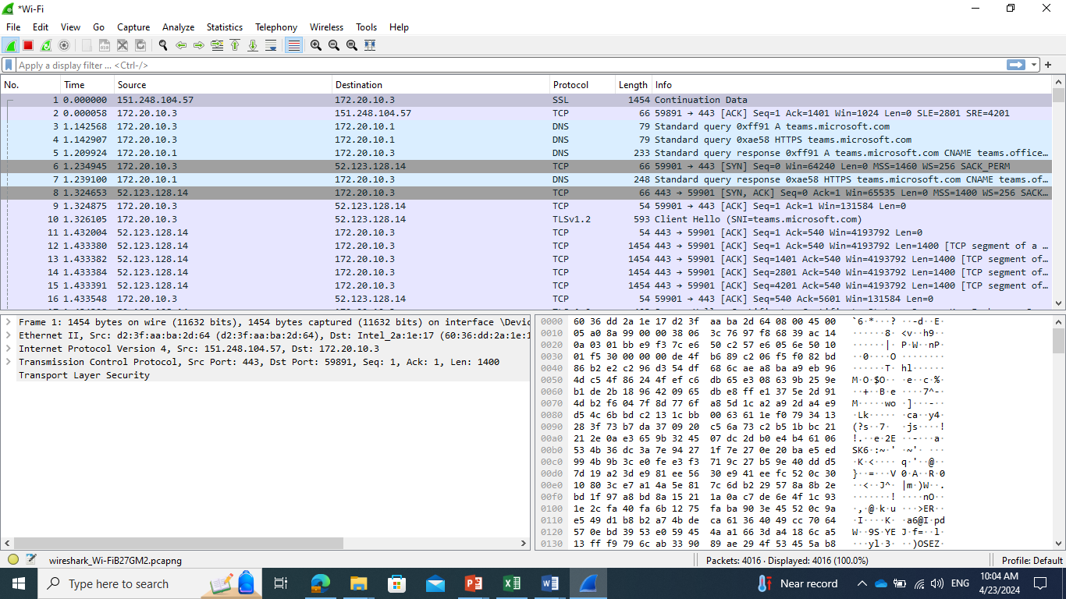

Slide 11
PCAP && PCAPNG
Examples the different related to comments.

Slide 12
Creating a new profile.
Add Columns
Changes Pans
Diagram Pan
Coloring Packets.
Etc.

Slide 13
Network Filters
Display Filters.
Capturing Filters.

